Slide 1
Git Basics
24.07.2014.

Slide 2
Table of contents
Real basics
Branching
Rebasing
Working with remote repos
Workflows
Resources

Slide 3
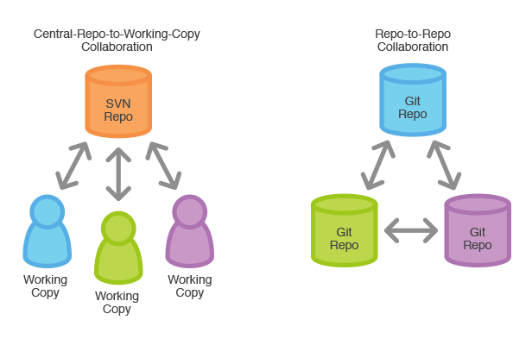
Real basics
Git is a free and open source distributed version control system designed to handle everything from small to very large projects with speed and efficiency - git-scm.com

Slide 4
Clone
git clone command copies an existing Git repository
Cloning automatically creates a remote connection called origin pointing back to the original repository

Slide 5
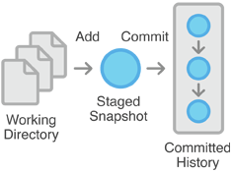
Add
git add command adds a change in the working directory to the staging area
It tells Git that you want to include updates to a particular file in the next commit. Doesn't really affect the repository in any significant way—changes are not actually recorded until you run git commit

Slide 6
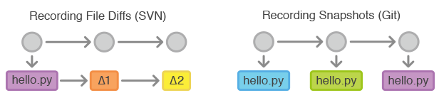
Commit
git commit command commits the staged snapshot to the project history
Snapshots are committed to the local repository, and this requires absolutely no interaction with other Git repositories.
Snapshots vs. Differences

Slide 7
Branching
Branching, in revision control and software configuration management, is the duplication of an object under revision control (such as a source code file, or a directory tree) so that modifications can happen in parallel along both branches - Wikipedia
A branch represents an independent line of development

Slide 8
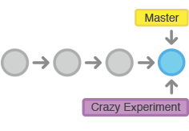
Branch
git branch command lets you create, list, rename, and delete branches
git branch <branch> creates (but doesn't checkout) new branch

Slide 9
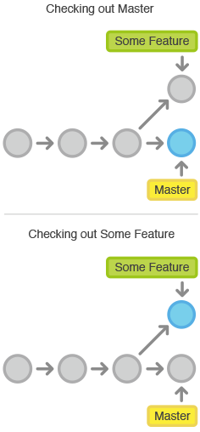
Checkout
git checkout command lets you navigate between the branches created by git branch
git checkout <existing-branch>
Checking out a branch updates the files in the working directory to match the version stored in that branch, and it tells Git to record all new commits on that branch

Slide 10
Merge
git merge command lets you take the independent lines of development created by git branch and integrate them into a single branch
git merge <branch> merges the specified branch into the current branch

Slide 11
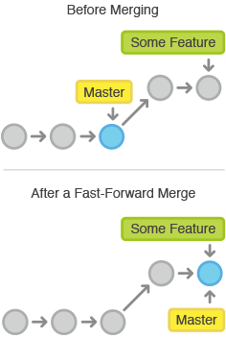
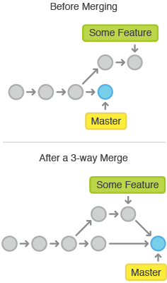
Merge
Fast-forward merge can occur when there is a linear path from the current branch tip to the target branch
When there is not a linear path to the target branch, Git has no choice but to combine them via a 3-way merge

Slide 12
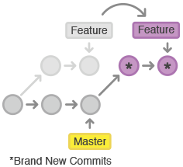
Rebasing
Rebasing is the process of moving a branch to a new base commit
From a content perspective, rebasing really is just moving a branch from one commit to another, but internally Git is rewriting your project history

Slide 13
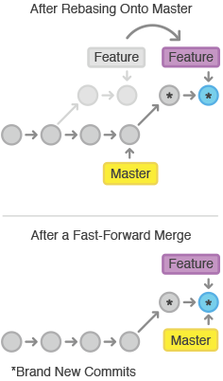
Rebasing
git rebase <base> rebases the current branch onto <base>, which can be any kind of commit reference (an ID, a branch name ...)
Primary reason for rebasing is to maintain a linear project history.
You should never rebase commits that have been pushed to a public repository!

Slide 14
Working with remote repos
Every developer has their own copy of the repository, complete with its own local history and branch structure
Users typically need to share a series of commits rather than a single changeset
Git lets you share entire branches between repositories

Slide 15
Fetch
git fetch command imports commits from a remote repository into your local repo
git fetch <remote>
Resulting commits are stored as remote branches instead of the normal local branches

Slide 16
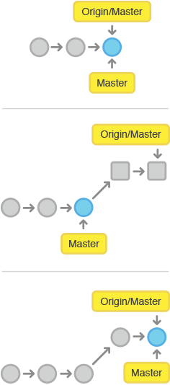
Pull
git pull = git fetch + git merge
git pull <remote> fetches the specified remote’s copy of the current branch and immediately merge it into the local copy

Slide 17
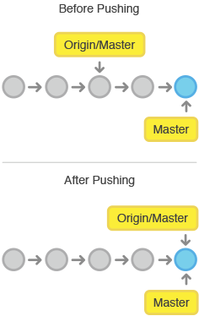
Push
git push enables you to transfer commits from your local repository to a remote repo
git push <remote> <branch> pushes the specified branch to <remote>, along with all of the necessary commits and internal objects.

Slide 18
Workflows
Centralized Workflow
Feature Branch Workflow
Gitflow Workflow
Forking Workflow
Pull Requests
Workflow itself isn't that important, consistency is!

Slide 19
Resources
Offical web page - http://git-scm.com/
Atlassian Git Tutorials and Workflows - https://www.atlassian.com/git
Pro Git book - http://git-scm.com/book

